Slide 1
Lecture 01: Introducing C
The Quartermaster Branch

Slide 2
Table of Contents
How C Was Born
C’s Advantages
C’s Disadvantages
Prerequisites - Basic Computer Knowledge
High Level Languages (HLL)
How Computers Compute Your C Code
References

Slide 3
How C Was Born
1972 - Dennis Ritchie (from Bell Labs) created C
Created while he and Ken Thompson were designing UNIX
Created after Ken Thompson created B Lang.
Goal: to be useful for modern goodness, while teaching basic programming principles and comprehension.

Slide 4
2. C’s Advantages
Portability
executable on different systems (with little/no modifications)
Compilers (discussed in further chapters) are available for every architecture.
Power + Flexibility
Most Operating Systems are written in C (UNIX)
Many Compilers + Interpreters for Python, Perl, FORTRAN, Pasca, etc are written in C.
Programmer Oriented
gives you access to hardware, memory manipulations
more flexible than other programming langs such as C++, Pascal, etc (Could become a disadvantage)
Provides useful libraries that contain many useful functions

Slide 5
3. C’s Disadvantages
Syntax
wrong usage of syntax (i.e, pointers) may make errors difficult to trace
Obfuscated Code

Slide 6
4. Prequisites - Basic Computer Knowledge
CPU (Central Processing Unit) - brain of the computer
repetitively fetches an instruction from memory, decodes it, and executes it
has registers which each one holds a memory address of the next instruction
(after instruction executes) the first register’s memory address is updated to the next instruction.
instructions - often related to moving a number from one location to another
a string of machine code that the CPU has to decode and execute.
the more CPUs, the more programs you can execute at the same time
RAM (Random Access Memory) - serves as a temporary workplace to hold programs and files (while the computer is on)
The more RAM, the more programs you can have open in the background (The computer packaging should tell whether your program is 8GB or 16)

Slide 7
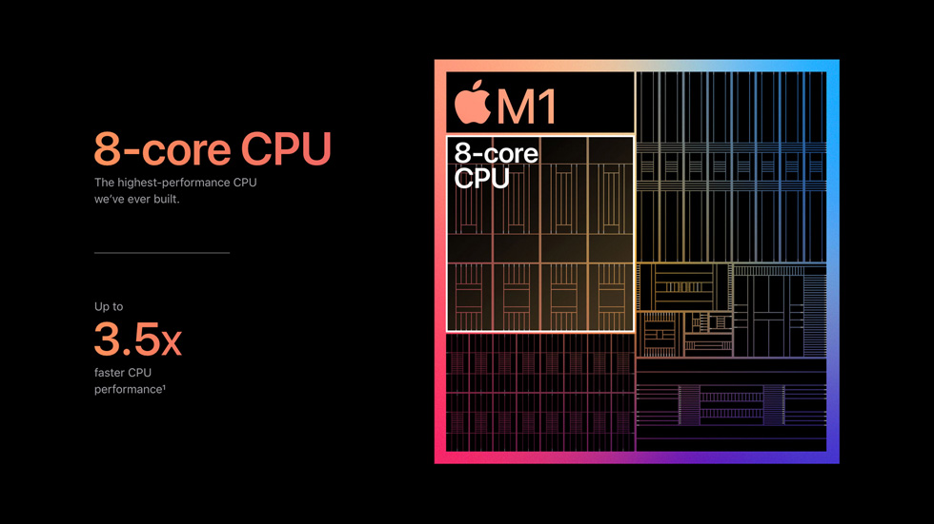
4. Prequisites - Basic Computer Knowledge
Notes:
Let’s take for example, a typical Silicon Chip that Apple has started designing, after parting from Intel. This M1 Chip contains an 8-core CPU. As you count, there are actually 8 little CPUs inside this chip. The rest are the neural engine, GPU, etc. You can imagine how powerful and revolutionary this chip actually is.

Slide 8
4. Prequisites - Basic Computer Knowledge
Permanent Memory Storage - remembers those programs and files permanently, even while the computer is off
I/O Storage - The things you input into the computer…text, numbers, etc. by using an input device (mouse, keyboard) are displayed by output device (screen)
Machine Language - Numeric instruction code, which are instructions that the CPU follows after fetching an instruction from a register.
Numbers and characters are all stored as binary numbers (0,1) -> an instruction that the CPU executes is in machine language (a string of 0s and 1s)

Slide 9
5. High Level Languages (HLL)
You don’t have to express your instructions in numeric code
you can express ideas on a more abstract level
easier than learning machine languages
ex) total = mine + yours;
Compiler - translates high level language to machine language instructions (because the computer cannot understand high level languages)
Earlier, we said C is a portable language…but all high level languages are portable and here’s why
You can match a compiler to a particular machine language
ex) For a high level language code, such as C, you can match C’s compiler for an Intel Core i7 CPU and a compiler for an ARM Cortex-A57 CPU and still run both equivalently.

Slide 10
6. How Computers Compile Your C Code
Source Code File - contains the (C Language) rendition of your program design.
Object Code File - The direct translation of the source code in machine code, but…
The linker has not yet linked header functions from the libraries
The linker has not linked startup functions that link your program to the OS hardware
Executable Code (Executable Binary) - native language, machine language of computer
contains detailed instructions expressed in machine language
Linker - links the headers that are mentioned in the source code, and additional startup codes to the executable binary
Steps for compilation:
Write and edit your source code file
Compiling the source code will create an object file
The linker links the necessary header libraries and startup functions
The executable binary (executable program) is created
Run the executable program.
Debug. (Find errors and fix them)
Notes:
Note that startup codes depend on the hardware and the OS of the computer. Let’s say running a C program on a Linux AMD vs on a Windows AMD. Of course the two startup codes must be different from each other

Slide 11
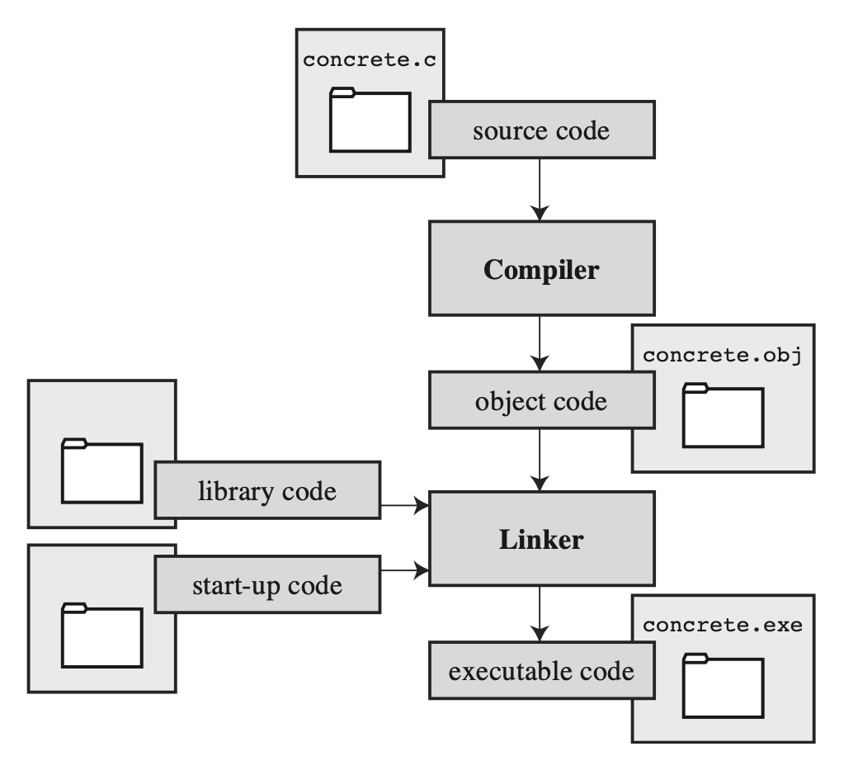
6. How Computers Compile Your C Code

Slide 12
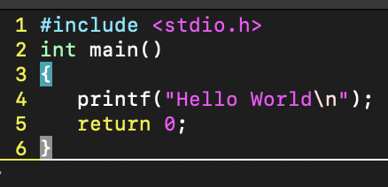
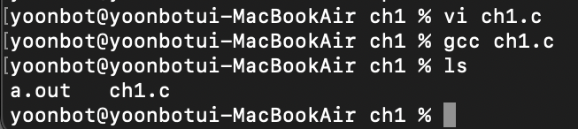
6. How Computers Compile Your C Code
Create and edit a C Program source code ch1.c using the “vi” command (When finished, type “wq” to save and exit)
You include c libraries using the “#include <header_name.h> format.
stdio = standard input output, .h = header extension
Compile the program by using the gcc ch1.c (Just using plain gcc skips creating object code files)
Then, there are two outputs: the a.out executable binary and the original source code ch1.c
a.out = assembler output
The next slide shows what’s inside the a.out executable binary.

Slide 13
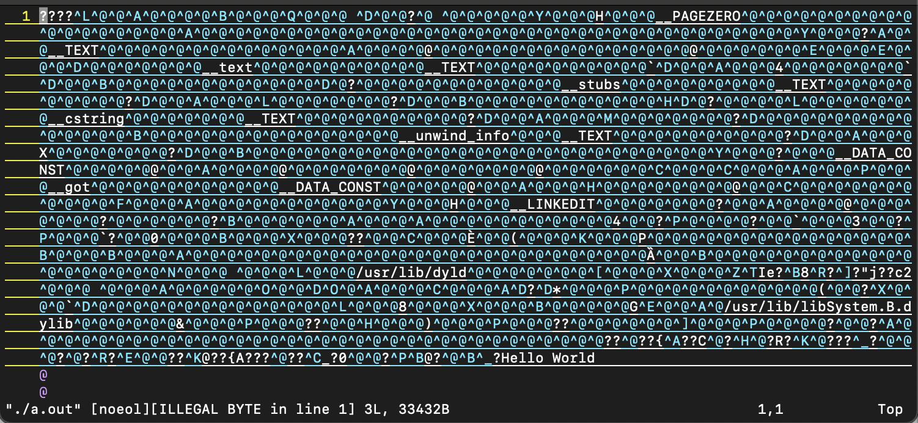
6. How Computers Compile Your C Code

Slide 14
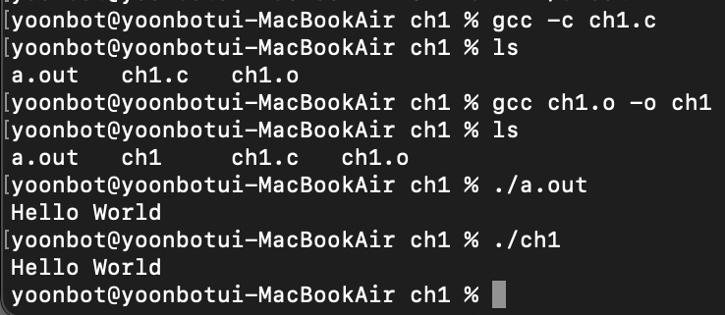
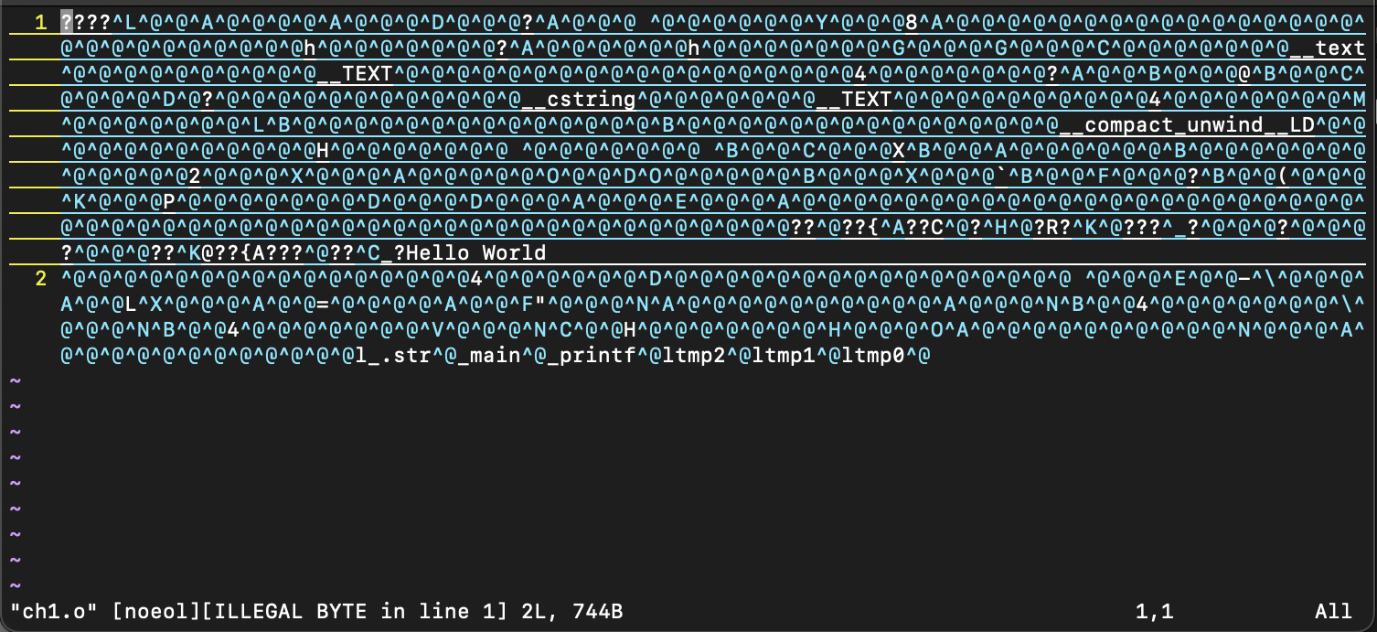
6. How Computers Compile Your C Code
gcc -c removes the automatic build up of an executable binary.
Instead, it creates an object code file (with an .o extension).
gcc object_filename.o -o links the object file to a linker, ultimately creating an executable binary.
This is why ./a.out and ./ch1 both produce the same output.
Why isn’t an object file appearing from the start?
Because we’re in UNIX. UNIX linkers automatically remove the object file once the executable program has been made.

Slide 15
7. References
Prata, Stephen. 2014, C Primer Plus, 6th ed. Boston: Addison-Wesley. Chapter 1.

